Slide 1
Planting & Harvesting
Tuesday Morning Short Mountain Bible Camp Justin D. Reed

Slide 2
Galatians 6:7-9
Plant (verb) – place [a seed] in the ground so that it can grow; place or fix in a specific position
Harvest (verb) – gather [a crop] as a harvest

Slide 3
Be Not Deceived – Verse 7
God knows all!
Acts 15:8
Mark 2:8
John 4:15-19
People try to mock God today
Lying to Him
Hypocrites

Slide 4
You get what you sow – verse 8
Flesh
Physical side
Galatians 5:19-21
Spiritual
Eternal side
Galatians 5:22-23
Galatians 5:24-26

Slide 5
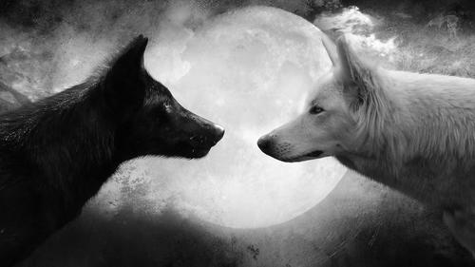
You get what you sow – verse 8

Slide 6
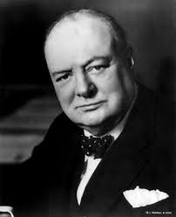
Don’t Grow Weary – verse 9
“Send the Light”
“Let us not grow weary in the work of love.”
“Heaven will surely be worth it all.”
Don’t get tired and give up!
Sir Winston Churchill
Matthew 14:23

Slide 7
Don’t grow weary – verse 9
II Thessalonians 3:13
Don’t become weary
Not for self-gratification
Keep going!
“Keep on the sunny side”
Colossians 3:2

Slide 8
What are you sowing?

Slide 9
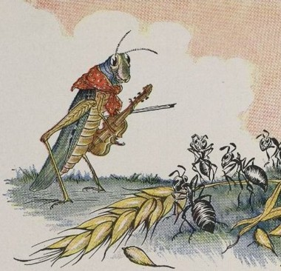

Slide 10
What you sow, you will reap
Hear – Romans 10:17
Believe – John 8:24
Repent – Luke 13:3, 5
Confess – Matthew 10:32-33
Be Baptized – Acts 22:16
Remain Faithful – Revelation 2:10

