Slide 1
Wednesday Night Bible Study
Noah: Flood & Salvation
Genesis 7:1-8:19

Slide 2
1. Time to Board the Ark – Gen. 7:1-15
2 – take the clean animals by 7s/ M & F
Clean? Lev. 11:3-8 – chews cud & split hoof
Unclean? Lev. 11:10 – either but not both
3 – take birds also
4 – one week until boarding the ark
5 – similar to 6:22
6 – Noah = 600 years old

Slide 3
1. Time to Board the Ark – Gen. 7:1-15
7 – boarded the ark
10 – God kept His word!
Noah may be deemed a failure by the world – he preached over 100 years and only saved 8 souls – but I call him a success because he saved his family!

Slide 4
2. On the Ark – Gen. 7:11-8:15
11 – 600th year, 2nd month, 17th day
First time to see it rain
12 – 40 days & nights of rain
13 – 8 souls entered the ark (1 Peter 3:20)
How many people died in the flood?
14 – animals entered also
16 – God shut the door

Slide 5
2. On the Ark – Gen. 7:11-8:15
18 – water continually upward
19 – NOT a ‘localized flood’
20 – 15 cubits (15 X 1.5ft = 22ft) higher
1 gal. of H₂0 = 8.345 lbs.
1 ft3 of H₂0 = 62.46 lbs.
29,050 ft³ of H₂0 = 1,813,532.25 lbs.
21 – all living things off ark perish

Slide 6
2. On the Ark – Gen. 7:11-8:15
24 – 150 days of water remaining
Destructive power of floods:
May 1-2, 2010 Nashville Floods
Grand Canyon formed
Cumberland Caverns – seashells in ceiling
Cathedral Caverns (AL) – sea sponge
American Museum of Natural History (NYC)

Slide 7
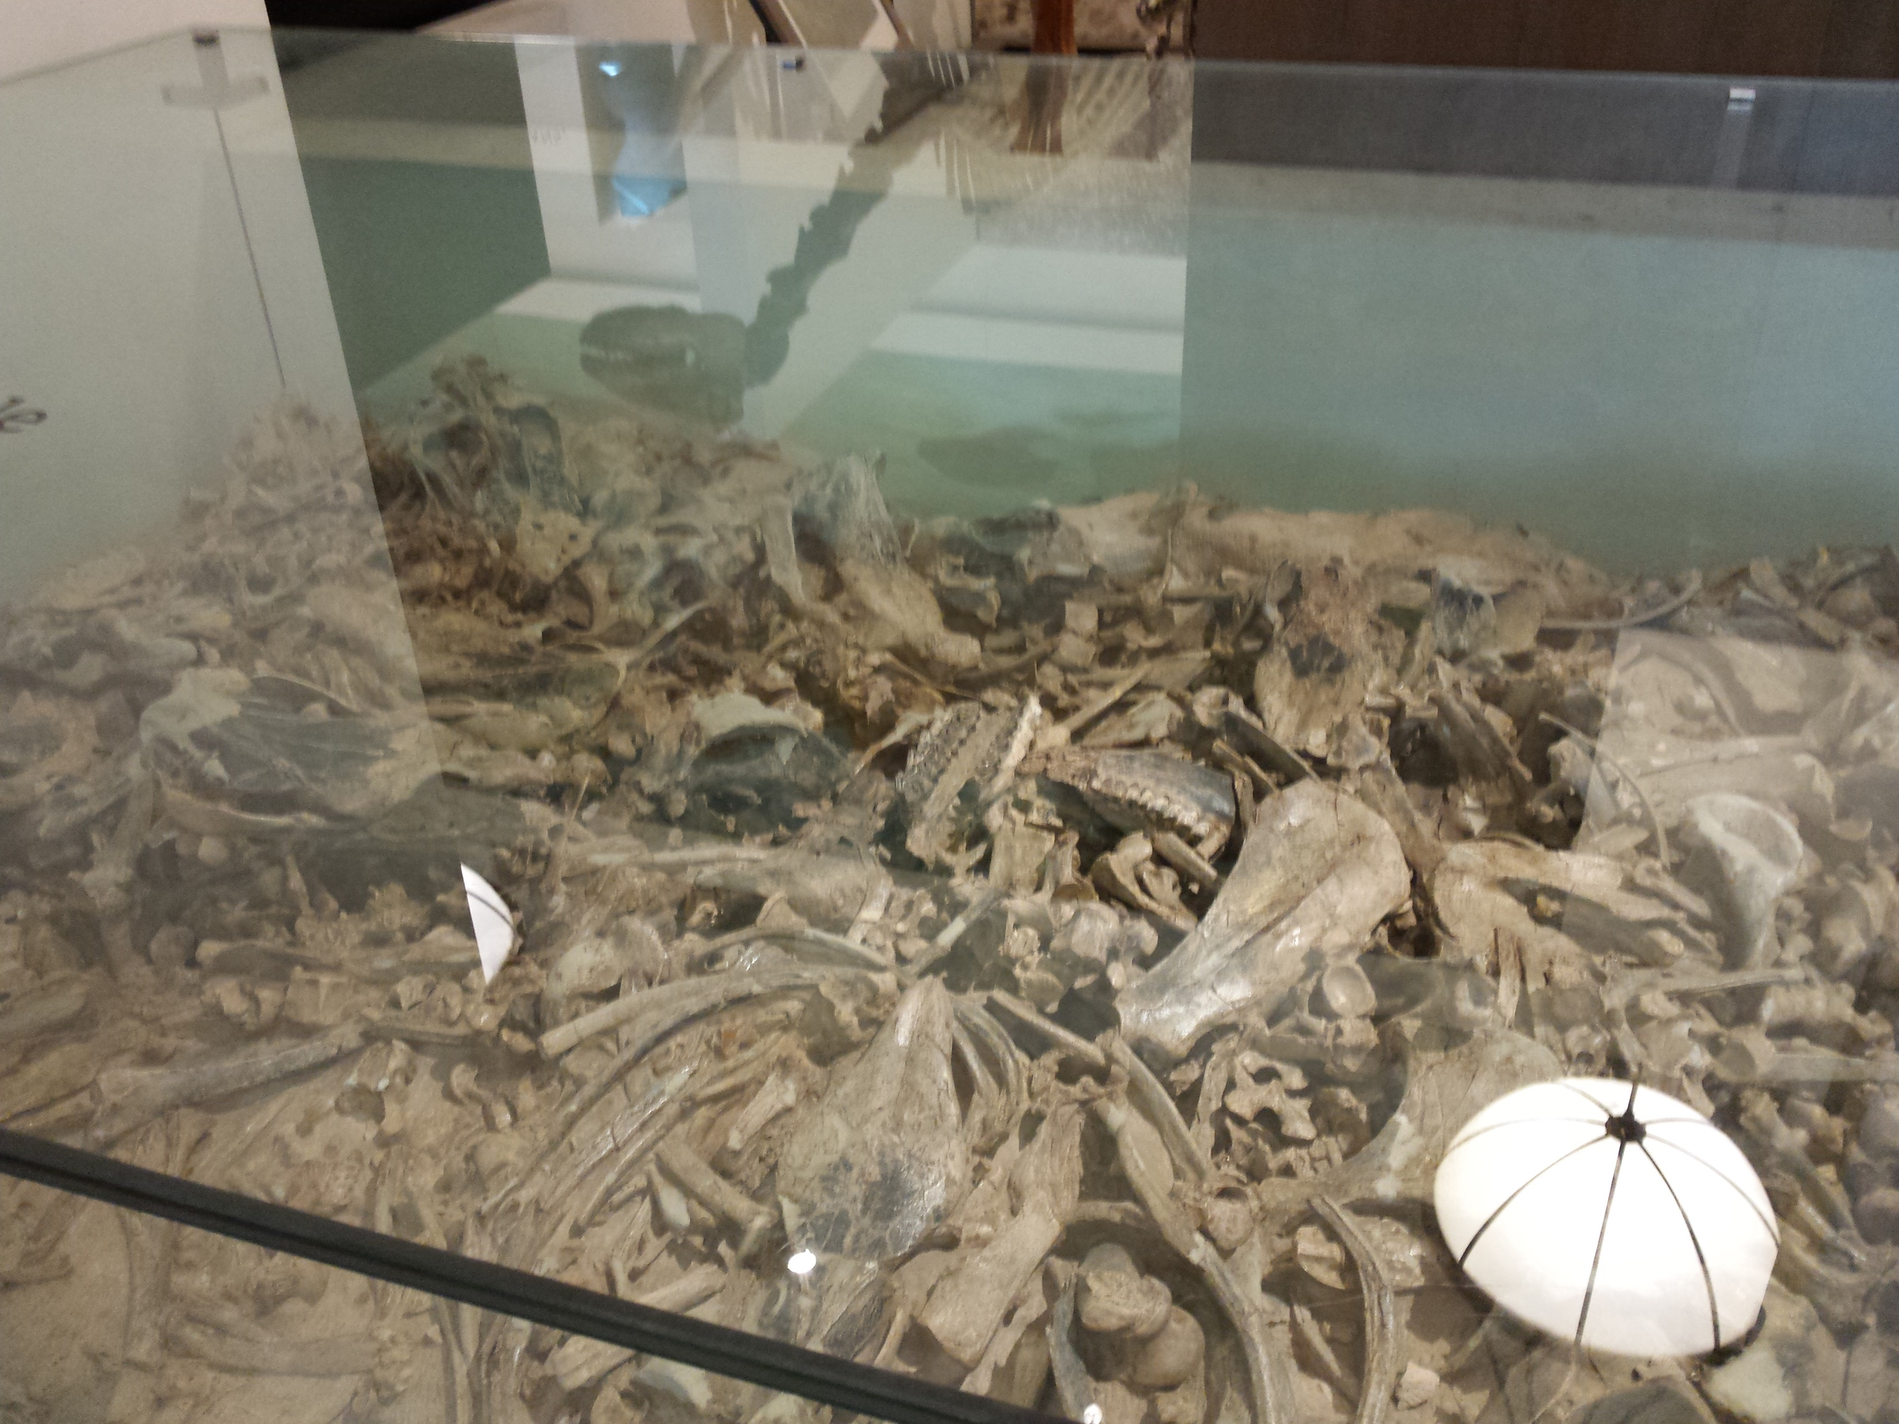

Slide 8
2. On the Ark – Gen. 7:11-8:15
8:1 – God remembers Noah
2 – stops raining
4 – rests on the 7th month, 17th day
Ararat – Armenia?
5 – water decrease until 10th mo., 1st day
6 – sending of birds
1st mention of opening the window

Slide 9
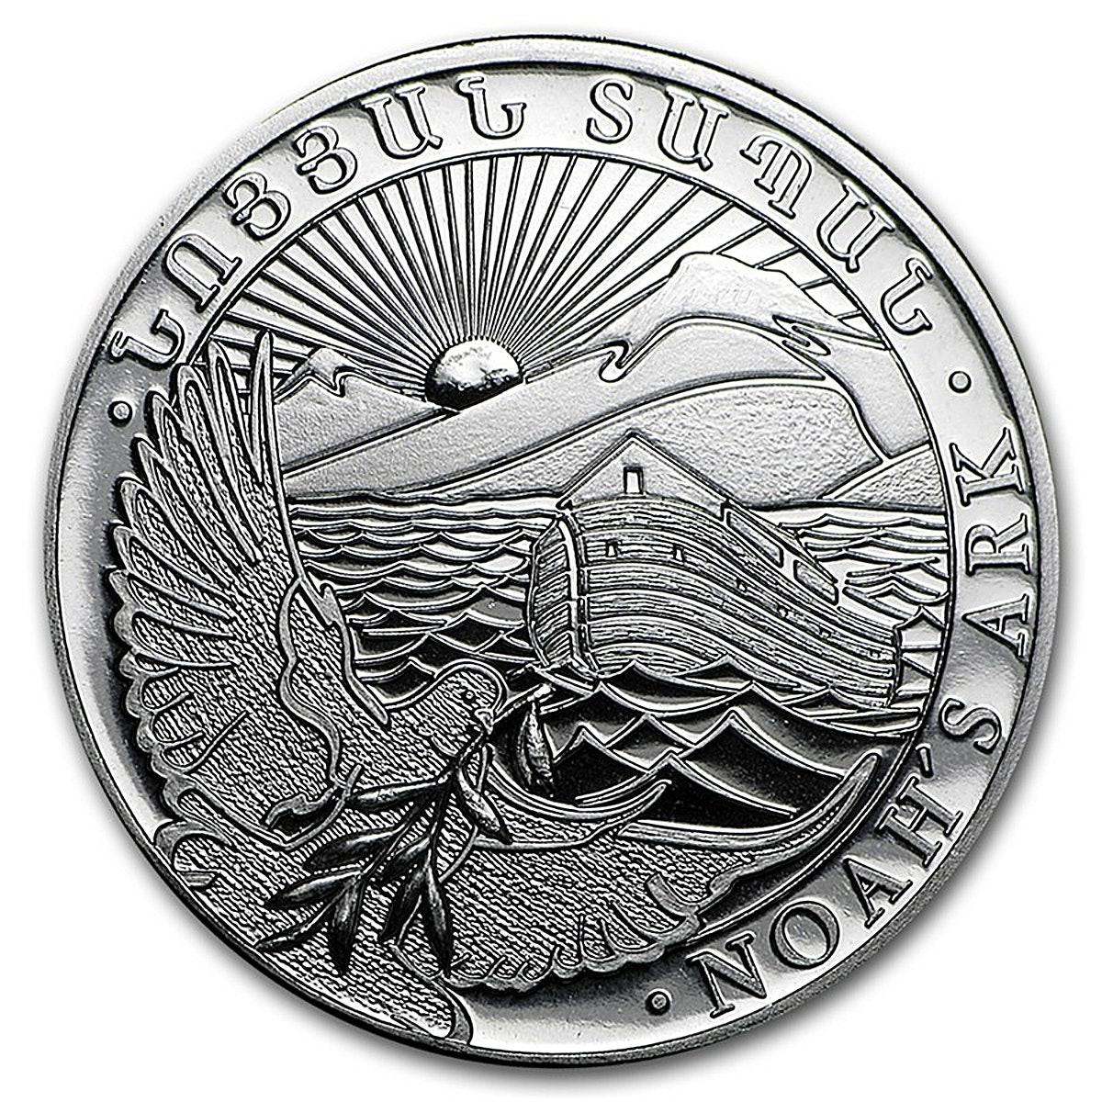

Slide 10
2. On the Ark – Gen. 7:11-8:15
7 – raven sent
8 – dove also sent
9 – dove returned
10 – waits 10 days
11 – brings back olive branch
12 – 7 more days

Slide 11
2. On the Ark – Gen. 7:11-8:15
13 – Noah: 601st year, 1st month, 1st day
14 – 2nd month, 27th day – Earth dried
How long were they on the ark?
370 days – one solar year
Biblical year – 360 days
Today: 365.25 days

Slide 12
3. Leaving the Ark – Gen. 8:15-19
Told to leave
Take the animals
No mention of the physical ark again
What happened when they got off? Next week’s lesson!

Slide 13
Lessons:
1. God will not contend with sin forever. He is not in the “sin tolerating business.”
2. The Judgment Day is coming.
3. God keeps His promises.
4. We serve a powerful God!
5. The “Ark” is never too small for one more.
6. We must develop distinctiveness.

Slide 14
Lessons:
7. We must trust God completely.
8. The Lord remembers and protects – 8:1

Slide 15
Next Bible Study:
Thursday 6:30pm
with Bill Boyd and Justin Reed

