Slide 1
“Live at Five” Series: How Heaven is Like the Grand Canyon
John 14:1-3

Slide 2
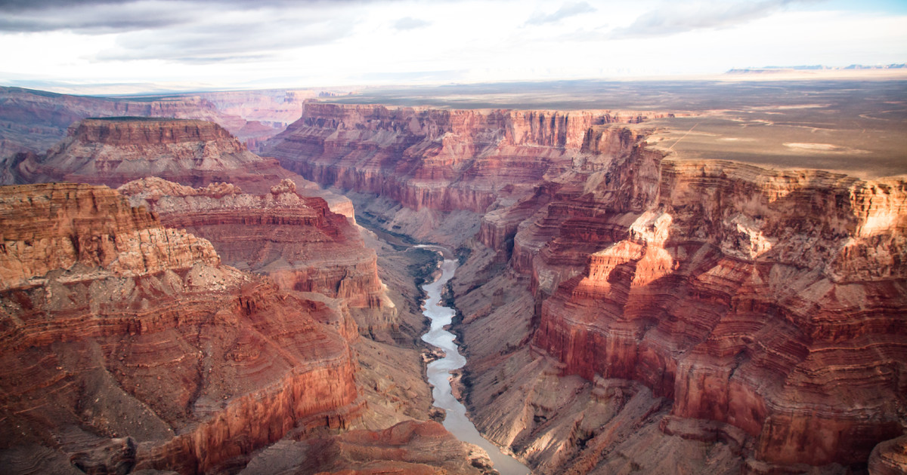

Slide 3
1. It’s Grand!
Big, beautiful, spectacular
Psa. 11:4 – where God lives
Full of beauty – Rev. 21:18-27
Full of spectacular blessings – Rev. 21-1-4

Slide 4
2. There is No Cheap Way Across
Costs something to get across – car, helicopter, walks
No cheap way into Heaven
Price: Blood of Jesus Christ – Acts 20:28
Heb. 10:19-20
Eph. 2:18

Slide 5
3. Many Just Want to Admire View
Many just want to see the canyon
Over 90% of Americans believe in Heaven
How to enter Heaven?
Do the Will of the Father – Matt. 7:21-22
Be converted – Matt. 18:3
Be born again (baptism) – John 3:3-5

Slide 6
4. Way to the Other Side is Narrow
How do you get to the other side?
Walk
8-10 miles
3 days
Narrow, curvy, difficult
Drive
About 200 miles
4-5 hours
Narrow, curvy, difficult
Way to Heaven
Matt. 7:13-14
Luke 13:23-24

Slide 7
5. Got to Go to Water
To cross, you have to go to the river
To get to Heaven, you have you go to water as well:
John 3:3-5, Acts 22:16, Rom. 6:3-4, Gal. 3:27
Just because you reach the water doesn’t mean you are finished – must finish the journey!
Heb. 12:1

Slide 8
6. If you Hike, Need Food & Drink
Nourishment is essential
To finish spiritual journey, essential also
Matt. 5:6-7 Blessed: hunger/thirst after righteousness
Need Bread of Life – John 6:51
Need Water of Life – Rev. 22:17
“Fountain Free”

Slide 9
7. Must Pass Through the Valley!
Grand Canyon not just one valley but a series of ever deepening valleys!
Life is the same
Valley of trials – 1 Pet. 1:7
Valley of temptation – Jas. 1:17
Valley of death – Psa. 23:4
Heaven waits on the other side!

Slide 10
It is grand!
No cheap way across
Many just want to see view
Way across is narrow and few go there
Must get to water to get to other side
If you hike the trail, food & water req’d
Must pass through valley

Slide 11
Notes available online:
thejustinreedshow.com/bibleresources
Google: Justin Reed Bible
Notes found in the ‘Sermons’ section.

Slide 12
Next Scheduled Live Study:
Wednesday 6:30pm – Midweek Bible Study “Peter’s Rooster”
Thursday 6:30pm – Matthew 16 with Bill Boyd and Justin Reed

