Slide 1
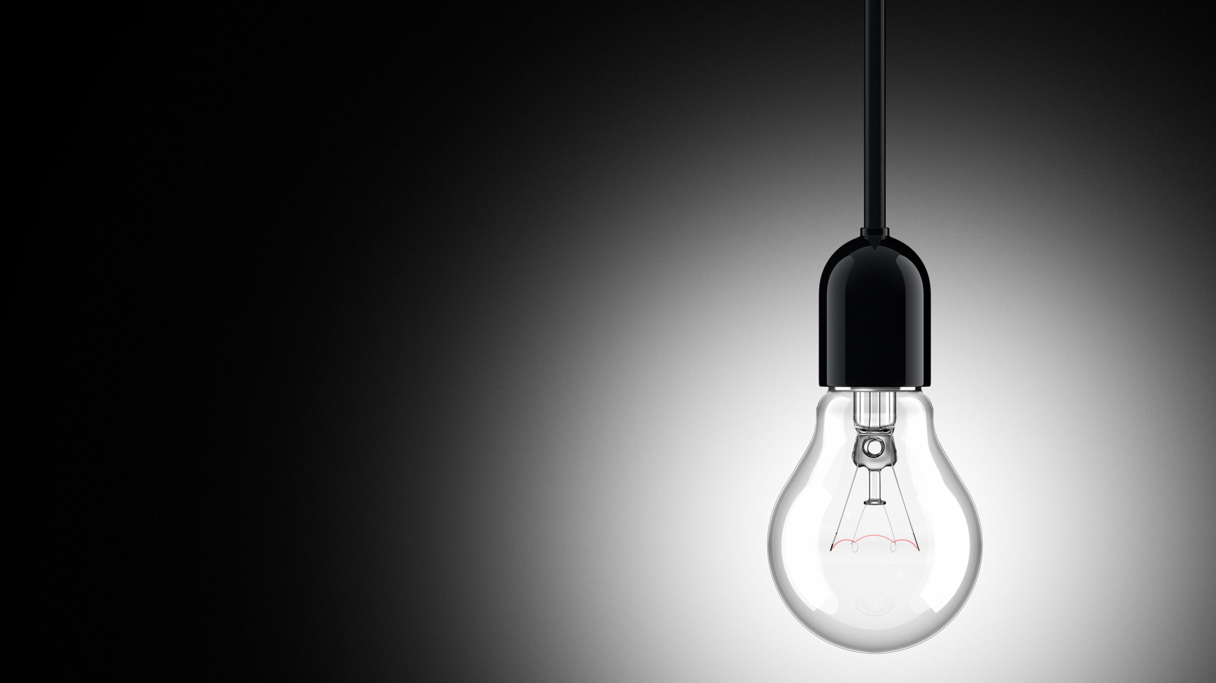
Christian Influence: Light
Matthew 5:13-16

Slide 2
Christian Influence: Light
Light is defined as “the natural agent that stimulates sight and makes things visible.”
Influence is defined as “the capacity to have an effect on the character, development, or behavior of someone or something, or the effect itself.”
Light (in all forms) appears 309 times in Scripture.

Slide 3
1. What Light Does
Guides
In darkness, we turn on the light to see where to go.
Psalm 119:105 – “Thy Word – Lamp”
When we turn on a lamp, no one turns it on to see the light itself, but what it shines on.

Slide 4
1. What Light Does
Attracts
Porch light & moths – blue light in bathroom.
We are to be a source that attracts the world.
Matthew 5:16
“You may be the only Bible some people ever read.”
Are you attracting people or detracting people for Christ?

Slide 5
2. Who Light Is
Jesus
John 8:12 – “I AM”
John 1:1-5, cf. v. 14 – light to shine in darkness
1 John 1:1-10 – light, walking in the light
Christians – representatives of Christ on earth
Matthew 5:14
Philippians 2:15
1 Peter 2:9, 12

Slide 6
3. How Light Works
Allows us a way to follow Christ – 1 John 1:7
Permits others to see Christ in us – Matthew 5:16, cf. 1 Corinthians 11:1
Applications of an influence (1 Peter)
Abstain from fleshly lusts – 2:11-12
Obey the laws of the land – 2:13-15
Be model employees at work – 2:18
Be faithful and loving to your spouse – 3:1-7
Live harmoniously with other Christians – 3:8-12
Be prepared to tell others about your faith – 3:15-16

Slide 7
Christian Influence: Light
How is your light shining?
Don’t be like an old strand of Christmas lights – by not shining as bright you affect those around you.
Use Jesus as our example of light and do our best to light up this dark world of sin.

Slide 8
Sermon © 2023 Justin D. Reed Presentation © 2023 Justin D. Reed
Provided free through Justin Reed’s Bible Resources Post Office Box 292, Woodbury TN 37190 thejustinreedshow.com/bibleresources
“To God be the Glory!”
320

