Slide 1
“Live at Five” Series: A Wise Heart
Colossians 3:23

Slide 2
A Wise Heart
2 kinds of hearts:
Physical organ that pumps blood through body
Biblically speaking refers to the mind
Heartily – defined – “in a hearty manner; very, to a great degree”
-ly ending = adverb
One way to “put the heart in heartily” is to study a wise heart

Slide 3
1. Wise Heart Defined
Exodus 28:3 – priestly garments, v. 1-3
“Wise-hearted”
Hebrew – חָכַם – chakam
Wise, cunning, intelligent, skillful, artful
Occurs 142 times in Scripture

Slide 4
1. Wise Heart Defined
Exodus 28:3 – priestly garments, v. 1-3
“Spirit of Wisdom” – II Timothy 1:6-7
Spirit of Power: Phil. 4:13
Spirit of Love: Jn. 3:16; 15:13
Spirit of Sound Mind – Jn. 8:32; 20:31
A complete picture: spirit of power, love, sound mind

Slide 5
1. Wise Heart Defined
Exodus 35:35 – building of Tabernacle
“Wisdom”
Hebrew – חָכְמַת־ – chokmah
Wisdom in a good sense
148 times in Scripture
Wisdom of Heart
Eph. 4:11
Pro. 2:10-17
Same word for wisdom; 49x as “wisdom” alone

Slide 6
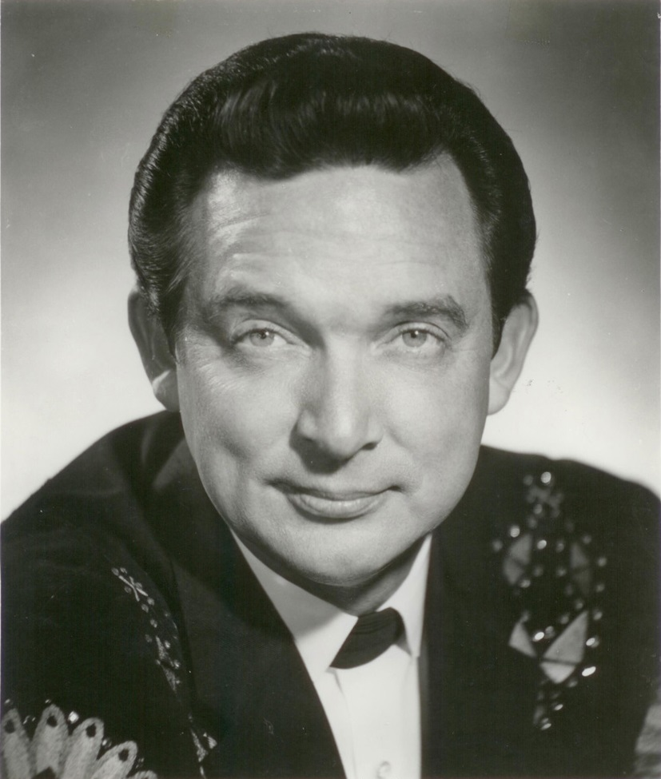
2. Relationship of Heart & Mind
Working Together
Pro. 23:7
Gal. 6:7-8
Working Against
1 Cor. 10:12
Gal. 6:7-8
Heart Over Mind
Mel Tillis
Ray Price

Slide 7
3. How to Develop a Wise Heart
Ask
Matthew 7:7-8
1 Kings 3:5-15 – Solomon
Don’t be afraid to ask but don’t ask amiss – Jas. 4:3
Imitate good examples – Romans 15:4
Joshua at Jericho, Noah, Abraham, Samuel, Isaiah, Andrew, 1 Cor. 10, Heb. 11, etc.
Continue to work on it – 1 Cor. 11:1; 1 John 1:7ff

Slide 8
A wise heart was required of Aaron as he was about to serve before God and the People.
A wise heart can be achieved if we have a desire to seek it out.
Develop a wise heart to be pleasing to God!

Slide 9
Notes available online:
thejustinreedshow.com/bibleresources
Google: Justin Reed Bible
Notes found in the ‘Sermons’ section.

