Slide 1
Salvation
Acts 4:12

Slide 2
Google
Launched in 1998 by Larry Paige and Sergey Brin
Name taken from “googol” – 1 followed by 100 zeroes
10,000,000,000,000,000,000,000,000,000,000,000,000,000,000,000,000,000,000,000,000,000,000, 000,000,000,000,000,000,000,000,000,000,000
The World’s #1 Search Engine

Slide 3
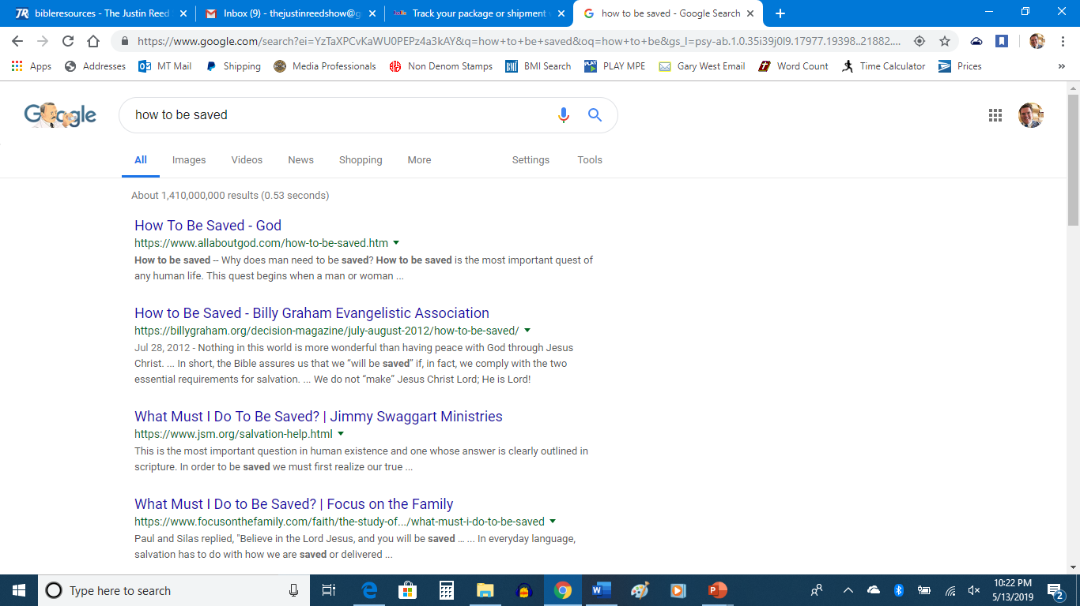

Slide 4
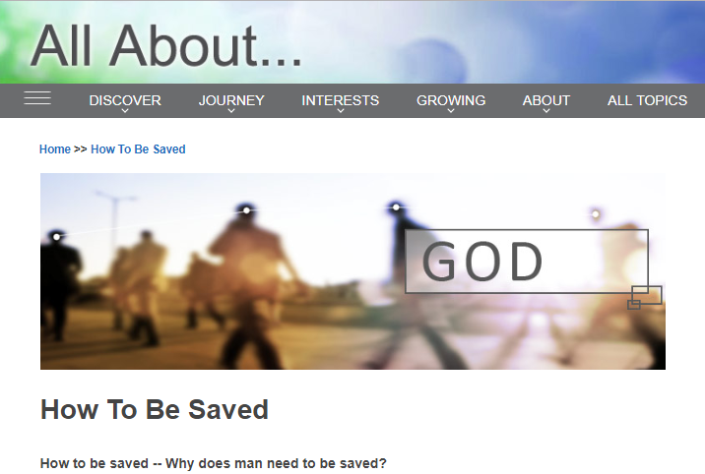
1. What Does Google Say is Required?
AllAboutGod.com
Acknowledge Sin
Recite Sinner’s Prayer
Tell Others

Slide 5
1. What Does Google Say is Required?
BillyGraham.org
Confess
Believe
Link:

Slide 6
1. What Does Google Say is Required?
JSM.org
Believe
Sinner’s Prayer
Baptism – Downloadable tracts

Slide 7
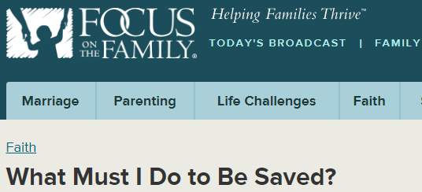
1. What Does Google Say is Required?
FocusOnFamily.com
Believe
Justified Faith

Slide 8
1. What Does Google Say is Required?
CreationToday.org
Believe
Repent
Sinner’s Prayer

Slide 9
1. What Does Google Say is Required?
JoeMcGeeMinistries.org
Video
Sinner’s Prayer

Slide 10
1. What Does Google Say is Required?
WikiHow.com – 2 options
Following the Bible
Asking for Salvation through prayer

Slide 11
1. What Does Google Say is Required?
ActiveChristianity.org & TheChristianWorldview.org were the same
GotQuestions.org could not be found

Slide 12
1. What Does Google Say is Required?
What is the Sinner’s Prayer?
It is NOT found in the Bible
Siri & Alexa

Slide 13
2. What Does the Word of God Say is Req’d?
Example on Pentecost – Acts 2
Repent – 37, 38
Baptized – 38-41
Remission of sins – 38-47
Example in Samaria – Acts 8
Believed – 12
Baptized – 12, 13

Slide 14
2. What Does the Word of God Say is Req’d?
Example of the Eunuch – Acts 8
Believed – 36-37
Confessed – 37
Baptized – 38
Rejoiced – 39
Example of Saul – Acts 9
Baptized – 18
Sins washed away – Ac. 22:16

Slide 15
2. What Does the Word of God Say is Req’d?
Example of Cornelius – Acts 10
Believed – 44
Baptized – 48
Remission of sins – 43
Example of the Jailer – Acts 16
Believed – 31
Baptized - 33
Example of Lydia – Acts 16
Believed – 14
Baptized – 15
In order: hear, believe, repent, confess, be baptized

Slide 16
3. Who Should We Listen To?
We are going to be judges by the Word of God – John 12:48
The Word of God Remains – Matthew 24:35
God’s Word is perfect, doesn’t contradict – II Timothy 3:16-17
The choice is yours! – You know the steps, we have discussed them in great detail today!

