Slide 1
Walk as Children of Light
Short Mountain Bible Camp 2018 Justin D. Reed

Slide 2
Prerequisite: Baptism
Amos 3:3

Slide 3
1. Walk as Children of Light – Ephesians 5:8
Former life versus new life
We are living a new life
Note: Verse 11
Old man versus new man
Ephesians 4:22-24
Renewed – made better

Slide 4
1. Walk as Children of Light – Ephesians 5:8
I Corinthians 6:9-11
Awful list of sins
Key: verse 11
Leave the old man in the grave
Romans 6:1-4
You wouldn’t get someone out of the grave

Slide 5
2. You are the Light – Matthew 5:14-16
Jesus
John 8:12 – “I AM” statement
Came to shine light in darkness, John 1:1-5
Paul
Imitate Christ – I Corinthians 11:1
Don’t be Paul, be Paul imitating Christ
Imitate – little kids

Slide 6
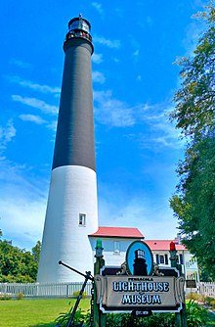
2. You are the Light – Matthew 5:14-16
Lighthouse
Pensacola Lighthouse
177 steps to the top
Light shines 27 miles. Why?
Above and beyond the call of duty – so must we!

Slide 7
2. You are the Light – Matthew 5:14-16
You never know who is watching you!
“Watching You”

Slide 8
3. Walk in the Light – I John 1:5-7
Read in context, I John 1:1-2:1
No darkness in God!
Should be no darkness in us!
I Peter 2:9 – peculiar people
WE CANNOT LOOK LIKE THE WORLD!

Slide 9
3. Walk in the Light – I John 1:5-7
Jesus has shown us the Way
John 14:6
“Where He Leads I’ll Follow”
“He the Great Example is and Pattern for me!”
Be like Noah – follow the plan!
“Follow Me”
Mark 1:16-20 – leave everything then
Us? Luke 9:23 - Daily

Slide 10
How do we follow Jesus today?
He has given the invitation – Rev. 22:17
1. Hear – Rom. 10:17
2. Believe – Mk. 16:16, Jn. 8:24
3. Repent – Lk.. 13:3,5
4. Confess – Mt. 10:32-33
5. Baptism – Mk. 16:16, Ac. 22:16
6. Remain Faithful – Rev. 2:10
7. Repent if in wrong – Lk. 13:3, 5

Slide 11
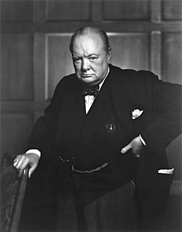
How do we follow Jesus today?
“Try Jesus – if you don’t like Him, the Devil will take you back!”
DO NOT leave this mountain not following Jesus and walking as children of light!

