Slide 1
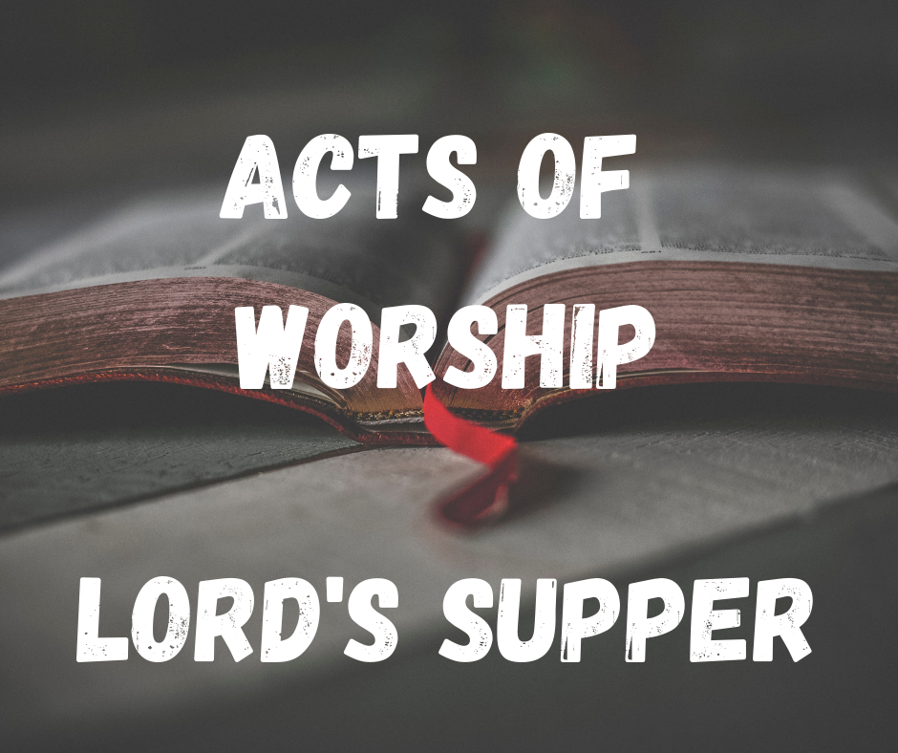

Slide 2
The Lord’s Supper
Every Sunday, Christians all over the world assemble to remember the Gospel – death burial, resurrection – of Jesus, 1 Cor. 15;3-4
Luckily for us, Jesus specified how He wanted us to remember Him.
Let us examine what the Bible says about the Lord’s Supper.

Slide 3
1. Background
Instituted by Jesus right before Passover
Luke 22:7-18 | Matthew 16:17-25
Passover: referencing & remembering the OT
At the 1st Passover, the children of Israel were to eat their fill so they could leave, Ex. 12:10
Passover was a full meal; the LS was not!
Passover a sacred memorial observed annually; LS different: remembering death of Jesus

Slide 4
2. Instituted
Matthew 26:26-29 | Mark 14:22-25 | Luke 22:17-20 | John doesn’t record
What happens?
JC takes bread, blesses, distributes. (Broken body)
JC takes juice, blesses, distributes. (Shed blood)
NOT HIS PHYSICAL BLOOD & BODY
Catholics teach “transubstantiation” > GROSS!
JC used what was at the meal!

Slide 5
3. Remembered
Acts – history of the church
2:42 – continued
20:7 – Paul at Troas, 1st day of the week
How many weeks have a first day?
1 Corinthians 11 – Paul recalling instructions
17: they weren’t doing everything right
23-25: quotes Jesus
26-29: self-examination
EVERY WEEK

Slide 6
3. Remembered
How long do we keep taking the LS?
Until Jesus returns!
If we are blessed with another 1st day, we partake.
It is done to show the death of Jesus until He comes.

Slide 7
The Lord’s Supper
Not just a common meal – it is something we should take with honor.
Jesus Christ died for us to be able to remember Him!
Each act of worship is essential to our worship!
Next time you take the Lord’s Supper, stop and think what it means – Jesus died for YOU!

Slide 8
Sermon © 2017 Justin D. Reed Presentation © 2021 Justin D. Reed
Provided free through Justin Reed’s Bible Resources Post Office Box 292, Woodbury TN 37190 thejustinreedshow.com/bibleresources
“To God be the Glory!”
178
Title card created by Justin D. Reed.

