Slide 1
The Danger of Social Drinking
Habakkuk 2:15

Slide 2
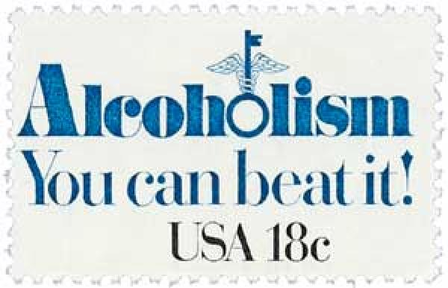
The Danger of Social Drinking
The goal of this lesson is to inform on what God says in His Word.
This topic is a hot one – even among the Lord’s Church sadly.
1. Example

Slide 3
2. Definitions
“Social Drinking” is defined as “no more than 7 drinks in a week and no more than 3 drinks per sitting.” National Institute for Alcohol Abuse and Alcoholism
“It’s just one drink!” Brown.edu: 1 drink = 1 12 Fl. oz. beer [5% alcohol] = 8-9 Fl. oz. malt liquor [7%] = 5 Fl. oz. wine [12%] = 1.5 Fl. oz. shot 80 proof distilled whiskey [40%]

Slide 4
2. Definitions
Statistics:
In 1990, 51% conservative Christians drank; 19.3% weekly drinkers.
Dept. of Justice: 4 in 10 violent crimes involve it
Dept. of Health & Human Services: involved in 2/3 of all sexual assaults.
Mothers Against Drunk Driving: someone is killed every 45 min. by a drunk driver.

Slide 5
2. Definitions
Consuming Alcohol:
Brown.edu: “different people will process alcohol at different rates. This means you could have the same number of drinks as a friend but feel greater effects from the alcohol they do.”
In TN, Blood Alcohol Content (BAC) of 0.08 is “legally intoxicated.” mg alcohol per mg blood
.02 results in loss of judgment, mood changes, relaxation, mild body warmth.”
.31-.45 can be life threatening

Slide 6
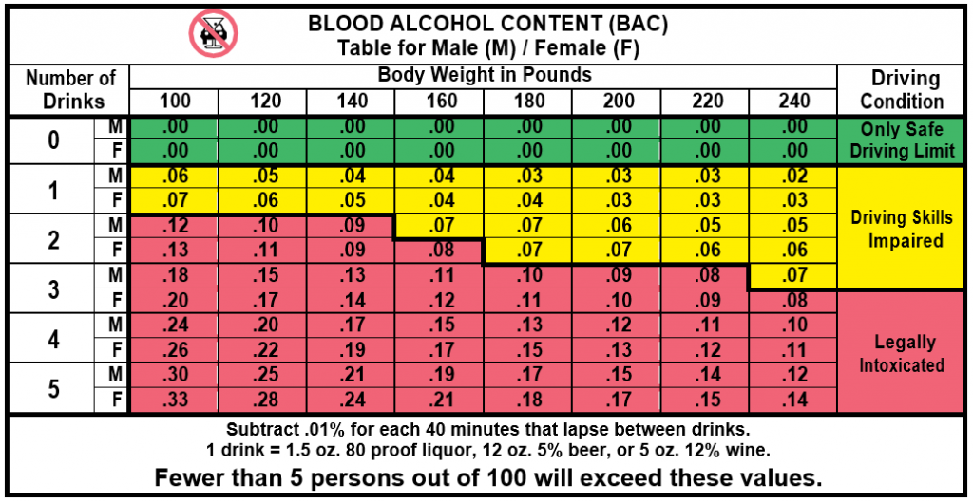

Slide 7
3. Biblical Reasons Not to Drink
1. The Christian is commanded not to, Eph. 5.18.
2. It weakens your resolve against sin, 2 Cor. 5:13.
3. It is destructive to the body, 1 Cor. 6:19, Mt. 6:33
4. It is an addictive substance, Isa. 5:11, 1 Cor. 6:12
5. It is a poor influence, 2 Cor. 6:17-18, 5:17.
6. It is a stumbling block, Rm. 14:21, 1 Cor. 8:13.

Slide 8
The Danger of Social Drinking
Dear friends, the next time you are confronted with an option to drink/social drink/be associated with alcohol, remember 1 Thess. 5:22!
What do I do if I social drink? Repent, Remove the alcohol/temptation, Resolve to live better!
Use this lesson to encourage faithfulness to others!

Slide 9
Sermon © 2022 Justin D. Reed Presentation © 2022 Justin D. Reed
Provided free through Justin Reed’s Bible Resources Post Office Box 292, Woodbury TN 37190 thejustinreedshow.com/bibleresources
“To God be the Glory!”
230
Chart from the California Department of Motor Vehicles. Postage stamp © 1981 USPS; Mystic Stamp photo.

