Slide 1
Standing on the Promises: Overcoming the Flesh
August 21, 2019
Justin D. Reed
Wood Church of Christ

Slide 2
1. Growing Spiritually in Christ
A. First, must get into Christ
1. Rom. 6:3-4
2. Gal. 3:27
B. Milk versus Meat
1. I Cor. 3:2
2. I Pet. 2:2
C. “Climbing the Christian ladder”
A. II Pet. 1:5-11
B. Key – v. 11

Slide 3
2. Works of the Flesh
A. Paul likes to give lists
1. Gal. 5:19-21
2. Rom. 1:29-32
3. I Cor. 6:9-11 [will revisit]
4. Eph. 5:3-5
5. II Cor. 12:20
6. I Tim. 1:8-11

Slide 4
2. Works of the Flesh
Abusers of themselves with mankind
Adulterers
All uncleanness
All unrighteousness
Backbiters
Boasters
Covenant breakers
Covetousness/ covetous man

Slide 5
2. Works of the Flesh
Debate
Deceit
Defile themselves with mankind
Despiteful
Disobedient/to parents
Drunkards/drunkenness
Effeminate
Emulations

Slide 6
2. Works of the Flesh
Envyings
Extortioners
Filthiness
Foolish talking
Fornication/ers
Full of envy
Hatred/of God
Heresies

Slide 7
2. Works of the Flesh
Idolatry/idolaters
Innovators of evil things
Jesting
Lasciviousness
Lawless
Liars
Maliciousness
Malignity

Slide 8
2. Works of the Flesh
Manslayers
Menstealers
Murderers/of fathers/of mothers
Perjured persons
Profane
Proud
Revelers/revellings
Seditions

Slide 9
2. Works of the Flesh
Sinners
Strife
Swellings
Theives
Tulmults
Uncleanness/unclean persons
Unholy
Ungodly

Slide 10
2. Works of the Flesh
Unmerciful
Variance
Whispers
Whoremonger/s
Wickedness
Witchcraft
Without natural affection
Without understanding
Wrath

Slide 11
2. Works of the Flesh
B. Gal. 5:21 – shall not inherit the kingdom
C. Rev. 21:8 – and all liars

Slide 12
3. How Do We Overcome?
A. I Cor. 6:9-11
1. Key v. 11
2. “were”
B. Cultivate good fruits
1. Gal. 5:22-23
2. A continual thing
C. Rom. 12:1
Good vs. Evil
Our choice

Slide 14
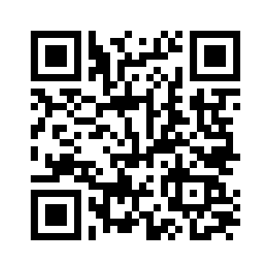
A Copy of Notes
www.thejustinreedshow.com/bibleresources
Google: Justin Reed Bible Resources – 1st option
Justin Reed Bible – 3rd option
Scan:
Under “Sermons”

Slide 15
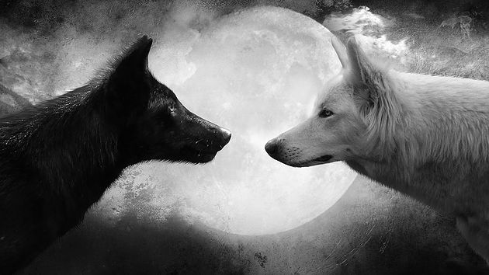
Two Wolves

Slide 16
How to be saved
Hear – Rom. 10:17
Believe – John 8:24, Mark 16:16
Repent – Luke 13:3, 5
Confess – Matt. 10:32-33
Baptism – Mark 16:16, Acts 22:16
Faithful – Rev. 2:10

