Slide 1
Spirit of Fear
Thursday Worship Short Mountain Bible Camp
July 13, 2017

Slide 2
Defined

Slide 3
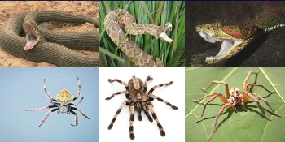
What? Why?
Unknown/future
Spiders/snakes
Difficult things/no experience
School/tests
Parents/teachers
Feel small, insignificant
Not in control
Attention taken off of self

Slide 4
Ecclesiastes 12:13
Only one thing to fear
The Great Commission
Matthew 28:18-20 – Teach all nations
Mark 16:15-16 – All the World
If Jesus said to go everywhere, and we don’t, IT IS SIN – James 4:17
Even if we are scared, we MUST share the Gospel!

Slide 5
Benefits of Sharing the Gospel
(Besides it is God’s Will)
1. Doing God’s Will
2. Saving Souls – each person has a soul
Why Do We Need to Share the Gospel?

Slide 6
1. We Don’t Have A Spirit of Fear
II Timothy 1:6-7
We have nothing to be truly afraid of!
Matthew 10:28 – don’t fear man
Romans 8:31 – If God is for us, . . .
We Do Have:
Spirit of Power – Philippians 4:13
Spirit of Love – John 3:16, 15:13
Spirit of a Sound Mind – John 8:32, 20:31 [We can know!]

Slide 7
1. We Don’t Have A Spirit of Fear
What are you afraid of?
God? Reverent fear is the only appropriate type
Anything else?
Stop being afraid!
It will only hinder you spiritually!
We Don’t Have A Spirit of Fear!

Slide 8
2. We Don’t Have to Be Ashamed!
Romans 1:16
Context: Romans controlled the whole world
Prophesied in Daniel 2
Had to live in accordance with Roman Law
Paul says regardless, he is not ashamed!
Ashamed: “Feeling shame, guilt, disgrace”
What would we need to feel ashamed of?
Sin
Imperfections
In Christ, there is no need to feel ashamed!
Matthew 10:32-33 – Ashamed of Jesus, He is ashamed of you!

Slide 9
2. We Don’t Have to Be Ashamed!
Why do we need not to feel ashamed?
Power of God unto salvation
To everyone that believeth
To Jew first, also Greek
The Gospel truly is for all!
“The Blessed Gospel is for all”
“I’m not ashamed to own my Lord…”
What are you ashamed of?
God? Don’t be!
Sin? Remove it from your life!

Slide 10
3. We Don’t Want Others to be Punished
II Thessalonians 1:7-9
Context: Return of Jesus
It will happen – be ready!
Previously mentions, I Thessalonians 4:17-5:1
When Jesus returns, those outside of Christ will be punished!
But “What If?”
All conditions laid out in V. 8
Not able to weasel out of it!
II Thessalonians 1:3-10
V. 5 – might suffer
V. 6 – Romans 12:17; 12:19

Slide 11
3. We Don’t Want Others to be Punished
How do we do our parts?
Matthew 28:18-20
Mark 16:15-16
Matthew 5:16
Are you doing your part?
Remember James 4:17
Imagine if the person that taught you never taught you, where would you be?
Imagine what will happen if you tell someone!

Slide 12
Do Your Part
Don’t Have the Spirit of Fear
Don’t Have to be Ashamed
Don’t Want to See Any Punished
“If we don’t, who will?”
Romans 1:16
Are you ashamed of God?
Or is He ashamed of you?
Are you ashamed of your sins?

Slide 13
Steps of Salvation
Hear the Gospel – Romans 10:17
Believe – John 8:24
Repent – Luke 13:3, 13:5
Confess – Matthew 10:32-33
Be Baptized – Matthew 28:18-20, Mark 16:15-16, Acts 22:16
Remain Faithful – Revelation 2:10

Slide 14
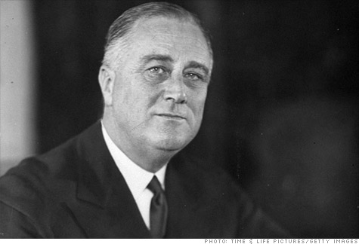
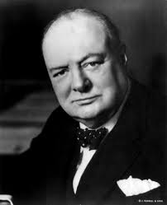
Don’t be afraid because you don’t have a spirit of fear!
We have nothing to fear but fear itself.

