Slide 1
Refocus Your Means
Romans 12:13

Slide 2
Refocus Your Means
Refocus is defined as to change the emphasis or direction of.
Means can be defined as our possessions.

Slide 3
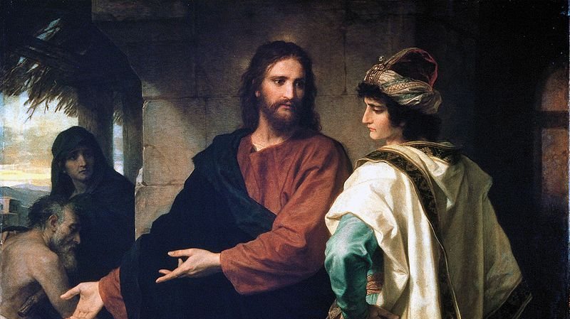
1. Rich Young Ruler – Mt. 19:16-22

Slide 4
1. Rich Young Ruler – Mt. 19:16-22
Context:
Questioned about receiving eternal life. From comparing all accounts (Mt. 19, Mk. 10:17-31, Lk. 18:18-30) we get his name Rich Young Ruler.
He was instructed on what he must do.
He leaves because he liked his possessions too much.

Slide 5
1. Rich Young Ruler – Mt. 19:16-22
Lesson:
The attitude of the ruler caused him to be lost.
The instructions from Jesus weren’t impossible – none of His commandments are. 1 John 5:3
Are we willing to let anything keep us from Heaven? Doing so will cost us eternally!

Slide 6
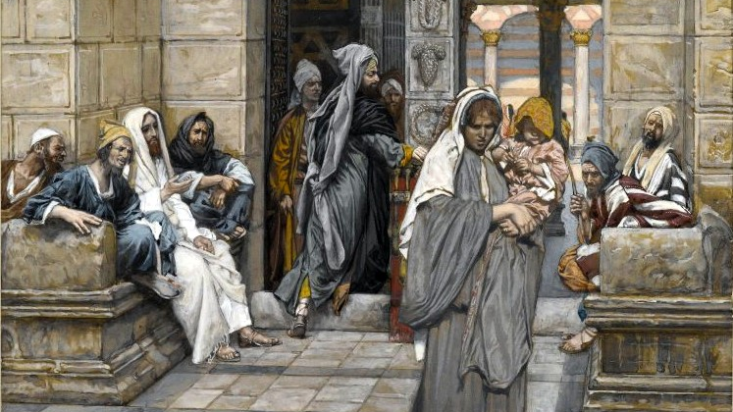
2. The Poor Widow – Mk. 12:41-44

Slide 7
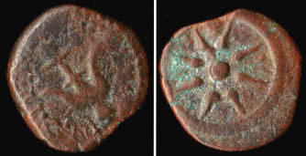
2. The Poor Widow – Mk. 12:41-44
Context:
Different way of giving
Coinage of the Roman Empire: according to Mark, two mites are equal to a quadrans, the smallest Roman coin. The mites, lepton, were the smallest and least valuable coin in Judea. Historians say they were worth about six minutes of work.

Slide 8
2. The Poor Widow – Mk. 12:41-44
Lesson:
She is praised for her attitude.
The rich are rebuked for their attitude.
2 Corinthians 9:7 – God loves a cheerful giver

Slide 9
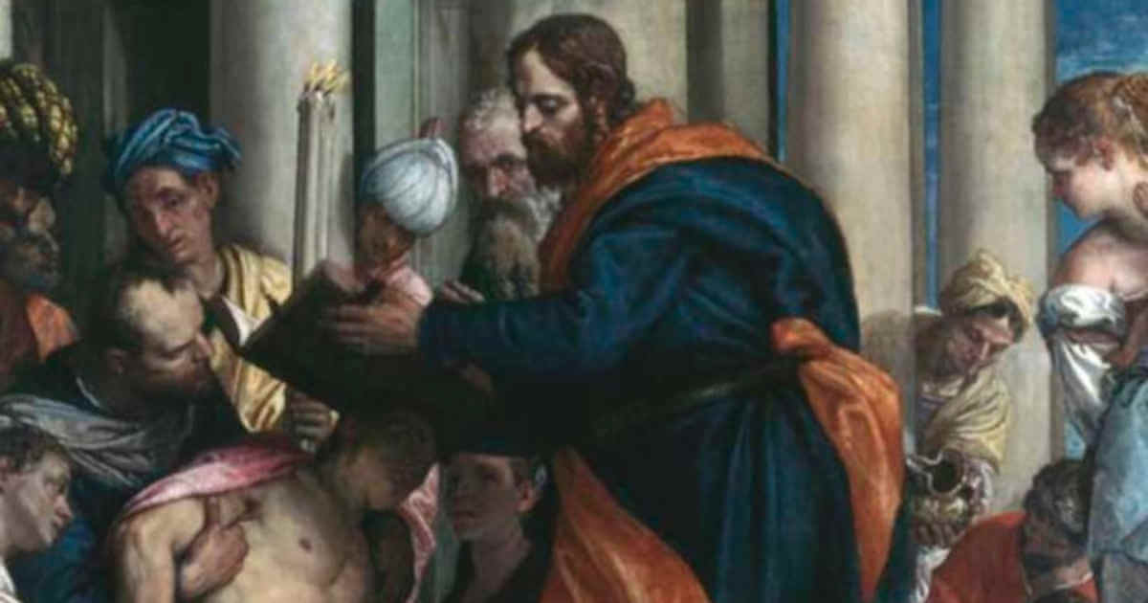
3. Barnabas – Acts 4:32-37

Slide 10
3. Barnabas – Acts 4:32-37
Context:
The early church, Acts 4: Determined Disciples, Peter and John were arrested in Ch. 3, and they preach in Ch. 4.
All the believers were united and sold their possessions. The early church was funded by their contributions.
Although many Christians gave, Luke, the inspired historian, records Barnabas’ name.

Slide 11
3. Barnabas – Acts 4:32-37
Lesson:
These early Christians saw their fellow Christians in need, so they gave.
Notice again, it is the attitude of these individuals.
Compare this to the deceitful attitude of Ananias and Sapphira in Acts 5:1-11!

Slide 12
How Do I Refocus My Means?
Give God more of my time.
Everyone is given the same amount of time in a day: 24 hours/1440 min./86400 sec.
Not watch as many videos or spend so much time just scrolling! “One of the devil’s primary goals is to keep you from reading your Bible so he can keep you ignorant of the truth. How is he doing?”
Example: reading 9 chapters a day gets the NT read in a month – 35 min./day!

Slide 13
How Do I Refocus My Means?
Give God more of my money.
We are commanded to give on the first day of the week – 1 Corinthians 16:1-2
Right now, at your age, you can give more to God.
Examples: not buying coffee/snack/etc. at $5 a day, 5 days a week (260 days), is $1300. Saving $13 a day, every day a year, is $4745!

Slide 14
How Do I Refocus My Means?
Give God more of my energy.
Refocus my activities –if all you spend your time working on or thinking of, it becomes an idol!
During your hobbies, talk to them about Jesus! Invite them to church!
Example DeHoff: if you are the only Christian in a town of 10,000, and you convert one person today, there are two of you. If the two of you each convert one person the next day, the number is four. Repeat. At the end of a month, all are converted.

Slide 16
Neighborhood Bible Study Mondays in January (2, 9, 16, 23, 30) Refreshments 6pm Study 6:30pm Topic: The Growth of the Church Acts 13-28

Slide 17
Sermon © 2023 Justin D. Reed Presentation © 2023 Justin D. Reed
Provided free through Justin Reed’s Bible Resources Post Office Box 292, Woodbury TN 37190 thejustinreedshow.com/bibleresources
“To God be the Glory!”
280

