Slide 1
Mistaken Identity: Have You Forgotten Who You Are?
1 John 1:9

Slide 2
Mistaken Identity
Identity: (noun) the fact of being who or what a person or thing is
Our identity has a lot to day about us & can be affected by: job, neighborhood, family, hobbies, education, friendship circle.
Our purpose: for those who have fallen away, to see where you were; how you got there; and how to get back to where you were.

Slide 3
1. Who Were You?
A Christian
How do we become? Hear, believe, repent, confess, baptism
Examples:
Cornelius, Ac. 11:13-14 – “words”
Eunuch, Ac. 8:36 – “what doth hinder me?”
Jailer, Ac. 16:33 – same hour, straightway, immediately

Slide 4
1. Who Were You?
Why are we called Christians?
Ac. 20:28 – Jesus shed His Blood
Gal. 2:20 – crucified with Christ

Slide 5
2. What Separated You?
Sin
Defined: “missing the mark,” 1 John 3:4
Commission vs. Omission – James 4:17
“It is always right to do right.
It is always wrong to do wrong.
It is never right to do wrong.
It is never wrong to do right.
And that’s right because the Bible’s right.” Dan Jenkins

Slide 6
2. What Separated You?
What does the Bible say?
Isa. 59:1-2 – it is not God’s fault
Rom. 3:23 – all sin – not an excuse to sin!
Rom. 6:23 – sin = death
2 Peter 2:20-22 – scariest verses: danger of falling away; better if hadn’t known

Slide 7
3. How Do I Get Back?
Must realize the need
Luke 15:17 – prodigal son came to himself
Feel like your life is in a circle with no hope to get out? Stop and turn to God!

Slide 8
3. How Do I Get Back?
What does the Bible Say?
1 John 1:9 – confess our sins & He will forgive!
James 1:21-25 – forgetting what you look like
Rev. 2:1-7 – church at Ephesus
Previously had a doctrine problem, Ac. 20:28-30, 1 Tim. 4:3
Now has a love problem – remember your first love
Key to fixing the problem: repent!

Slide 9
What if you’ve never obeyed the Gospel? See steps in point 1.
What if you’re a Christian and faithful? Keep pressing forward!
What if you’ve forgotten your identity? See the steps in point 3.
Remember: Rom. 8:1 – no condemnation in Christ!
We’ve looked at 32 verses now, “what will you do with Jesus? The question comes to you! What shall your answer be?”

Slide 10
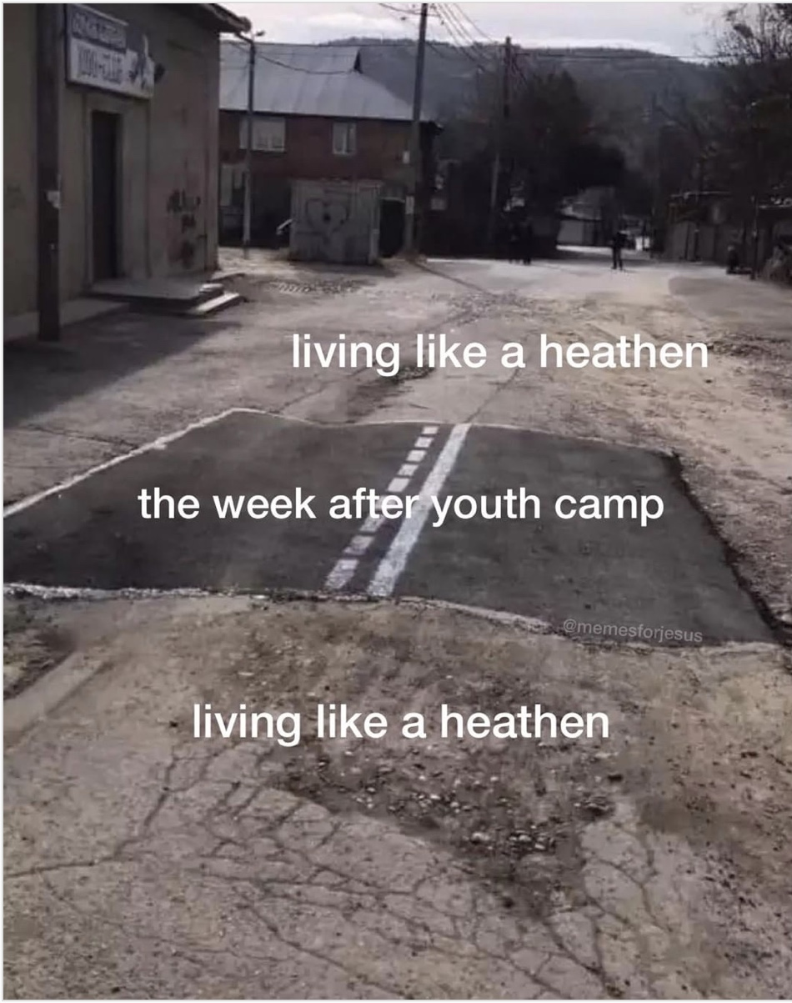

Slide 11
Sermon © 2021 Justin D. Reed Presentation © 2021 Justin D. Reed
Provided free through Justin Reed’s Bible Resources Post Office Box 292, Woodbury TN 37190 thejustinreedshow.com/bibleresources
“To God be the Glory!”
153
Meme courtesy of @memesforjesus on Instagram.

