Slide 1
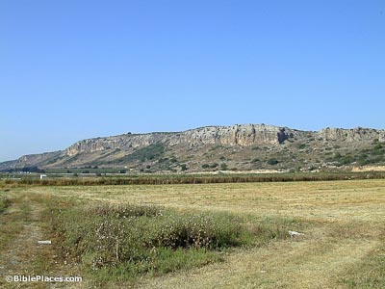
Elijah and Mt. Carmel
1 Kings 18:17-40

Slide 2
1. Elijah
9th Century BC
1st introduction – 1 Kings 17:1
Nothing of his childhood known
Name: “Yahweh is My God”

Slide 3
2. Background
Divided kingdom (Saul, David, Solomon, Split)
Idolatry widespread – God disapproves Ex. 20
Ahab – most wicked King [874-853BC]
Jezebel – wife
Married to form an alliance
Her dad: Ethbaal (I Kings 16:31) [915-874BC] Sidon
Overthrew other dynasties
Jezebel influenced Ahab to build worship centers

Slide 4
2. Background
Jezebel declared war on Israelites, slaughtered (1 Kings 18:4-8)
God sends Elijah to declare a drought (1 Kings 17:1; cf. James 5)
God ready to prove to the nations who He is!

Slide 5
3. Showdown – 1 Kings 18
1 – told to go to Ahab
3rd year of drought – just imagine
Presenting himself meant he was willing to die
2 – he went; true obedience
17 – Elijah knew he was not Israel’s problem, sin was!
18-19 – willing to stand up for what is right

Slide 6
3. Showdown – 1 Kings 18
20 – Mt. Carmel
Mountain range 13mi. From Med. Sea SE to plain of Dothan
Rises 470 feet [47 stories] (1/2 Rockefeller Center)
Easily seen mountain
Canaanites built sanctuaries to gods on mtn.
Near Northern border of Israel
Perfect place

Slide 7
3. Showdown – 1 Kings 18
21 – cannot waffle (Josh. 24:15; MT. 6:24)
23-24 – rules for contest
2 bulls
Cut in pieces
Lay on wood
NO FIRE
Call on the name of their god/gods
People determine which is God!
Baal – storm god who rides the clouds, send lightening

Slide 8
3. Showdown – 1 Kings 18
25-26 – from morning to noon no answer
There could never be an answer!
27 – Elijah sarcastic (why I like him!)
James 1:26 – our worship is vain if we have the wrong relationships/bridles tongue
28-29 – Response: loud cries, cut themselves, until evening time
Spent an entire day – nothing to show for it!

Slide 9
3. Showdown – 1 Kings 18
30-33 – Elijah’s answer
Called all the people
Rebuilt the altar
Made a trench
Commanded water to be poured 3x
Remember, they are in a 3 year drought!
35 – Why? Burn something from Heaven a great feat; the water leaves no room to doubt

Slide 10
3. Showdown – 1 Kings 18
36-37 – Teaching through prayer
38 – Answer that proved the point!
39 – Only acceptable answer
40 – Wicked never escape punishment
3 groups of people: (a) followers of Baal; (b) followers of God; (c) confused, not sure
Only one group at the end of the day!

Slide 11
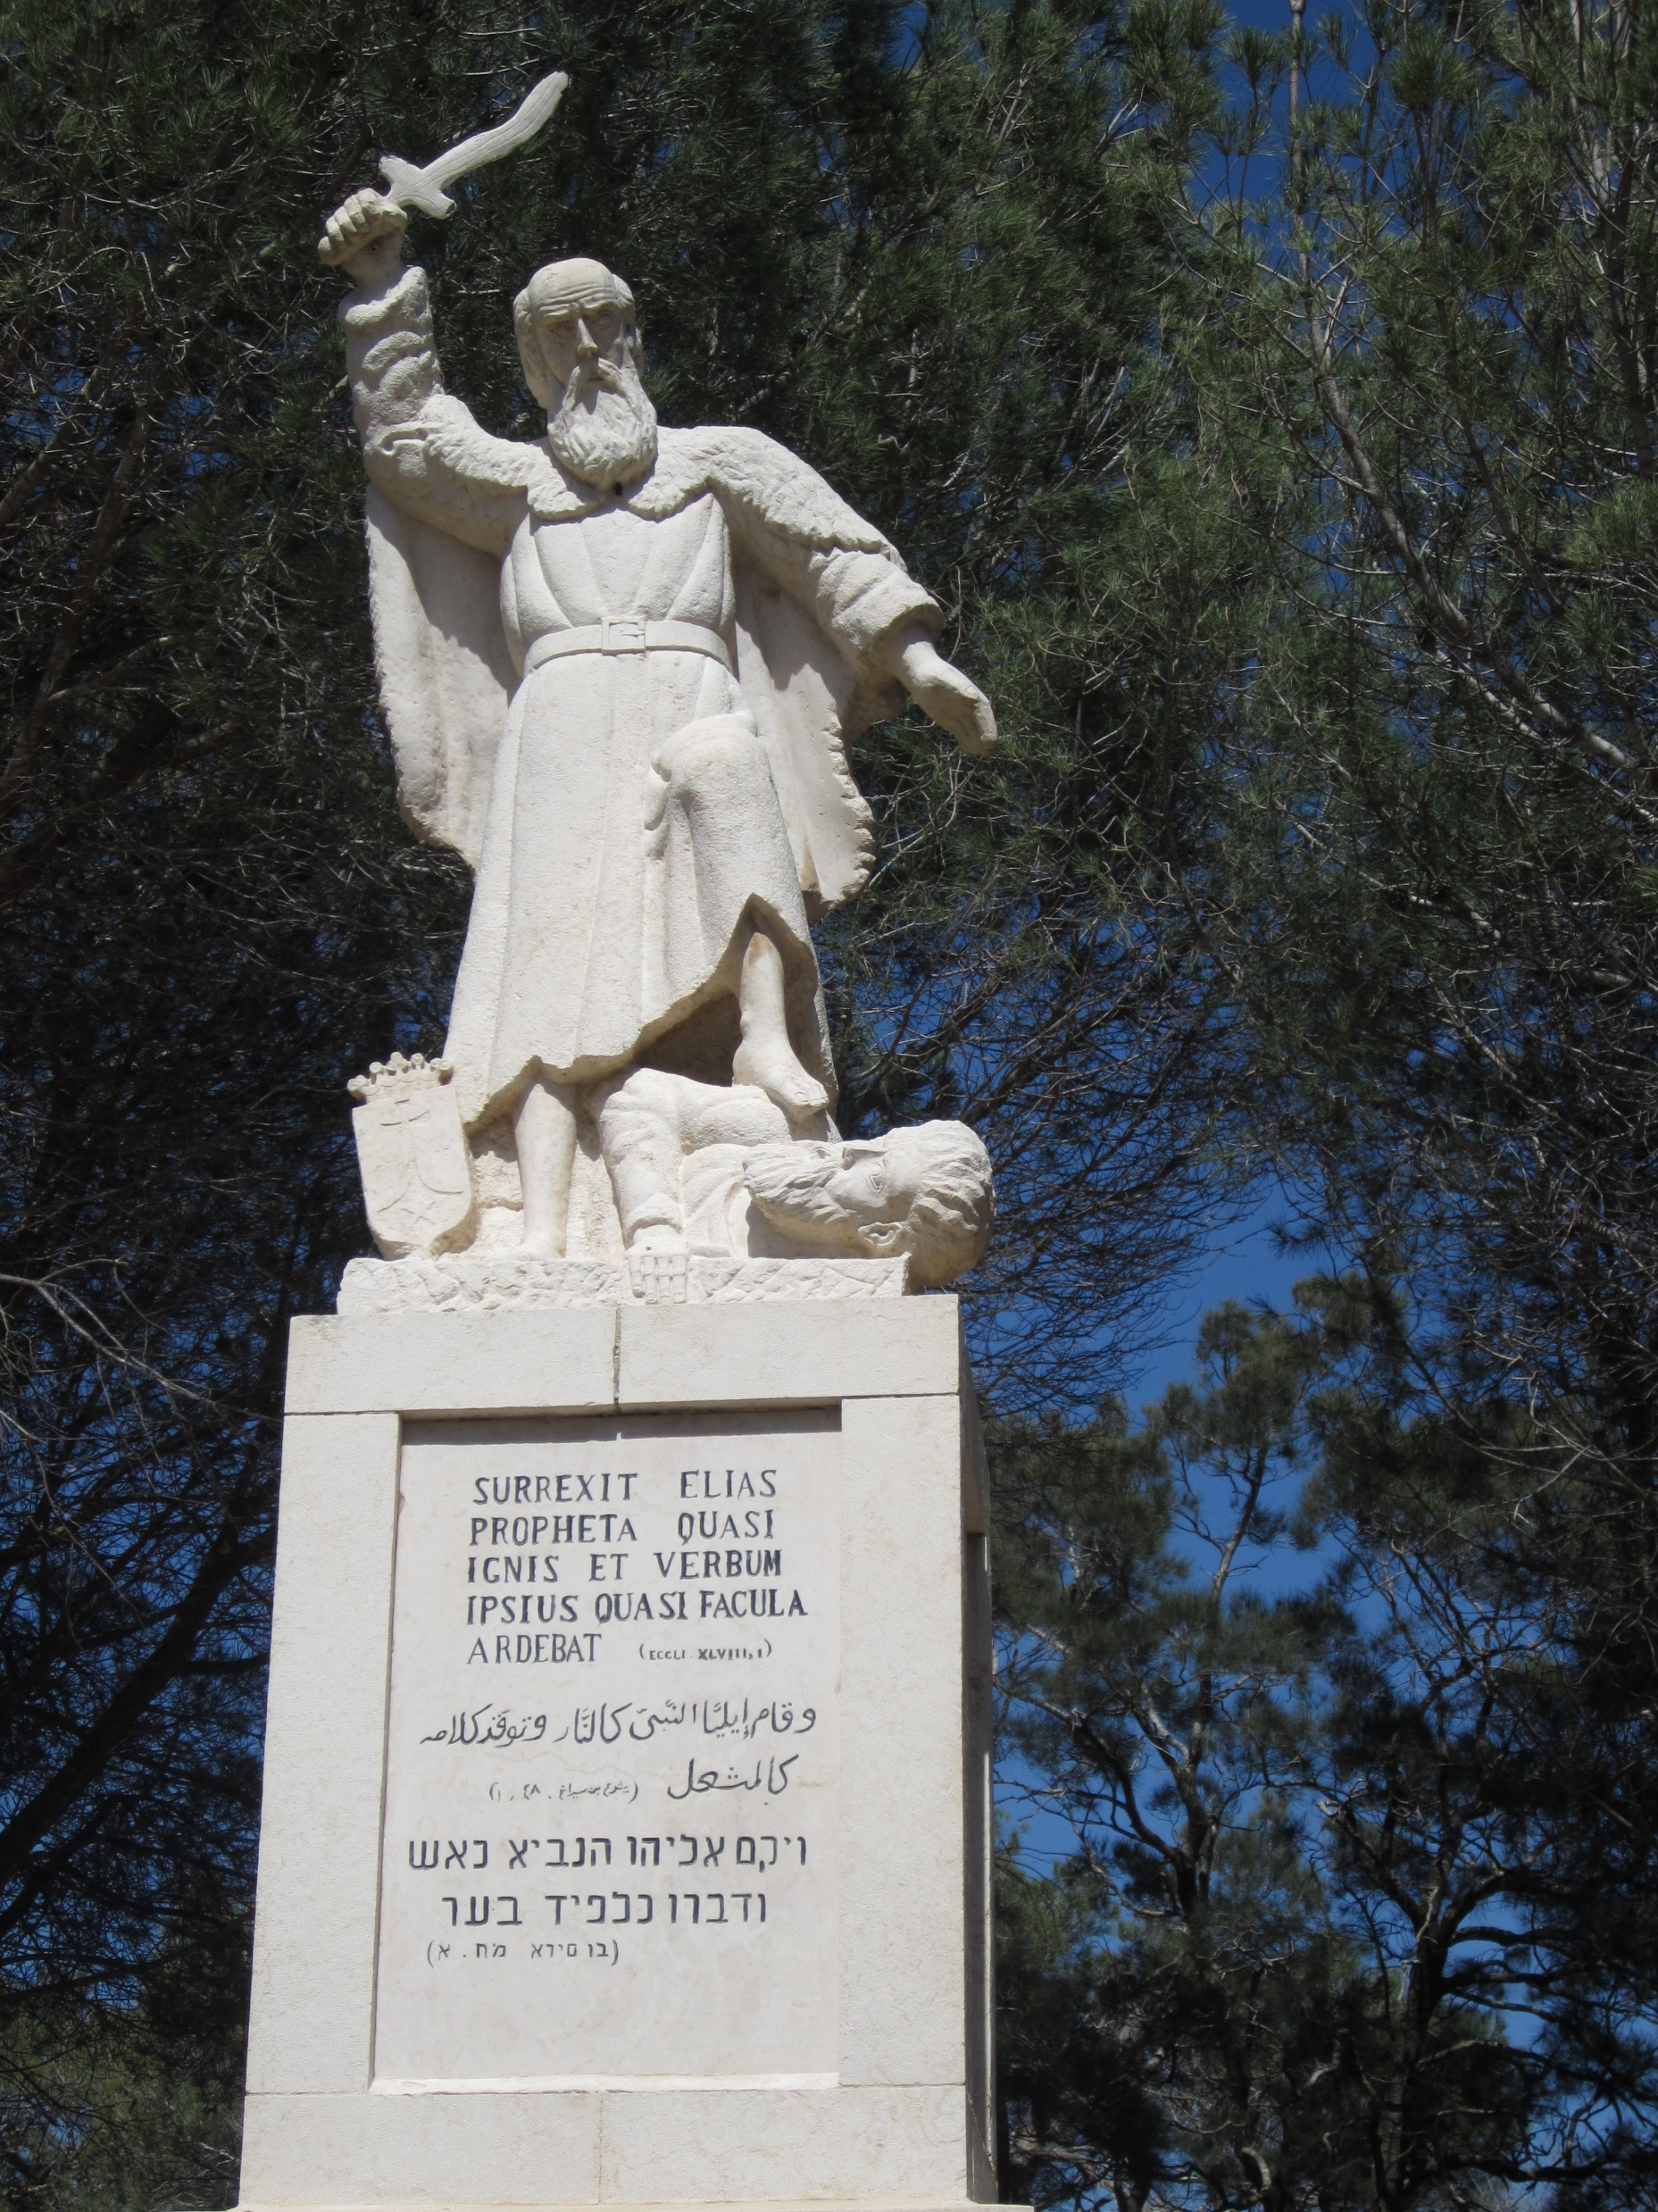
4. Conclusion
41-46 – Baal was defeated
God was praised
Today – there is a statue of Elijah atop Mt. Carmel to commemorate this event

Slide 12
Lessons Learned
We study the OT to learn (Rm. 15:4)
Elijah’s faith put him in a place where he conflicted with the government; he did not waver. What about you and your faith?
Don’t give in to pagan worship – just because the world is doing it doesn’t mean you should be doing it!

Slide 13
Next Scheduled Study: Thursday 6:30pm – Matthew 19 with Bill Boyd and Justin Reed Sunday 11am Online and in the building Wood Church of Christ, Woodbury

Slide 14
Sermon ©2017 Justin D. Reed Presentation ©2020 Justin D. Reed
Provided free through Justin Reed’s Bible Resources Post Office Box 292, Woodbury TN 37190 thejustinreedshow.com/bibleresources
“To God be the Glory!”

